Slide 1
Student Engineers
As
Employees
- or -
How Student Engineers
Built My Observatory
Dr. Gerry Ruch
University of St. Thomas
Department of Physics

Slide 2
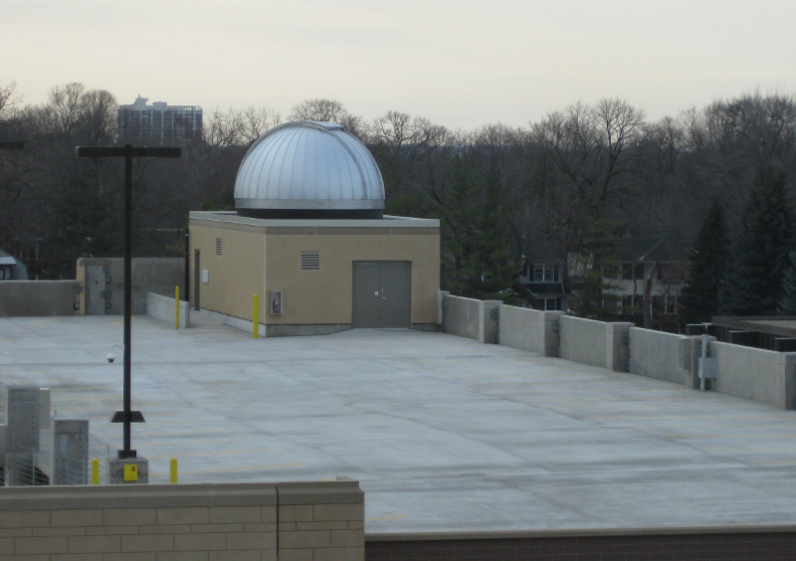
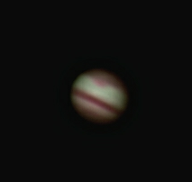
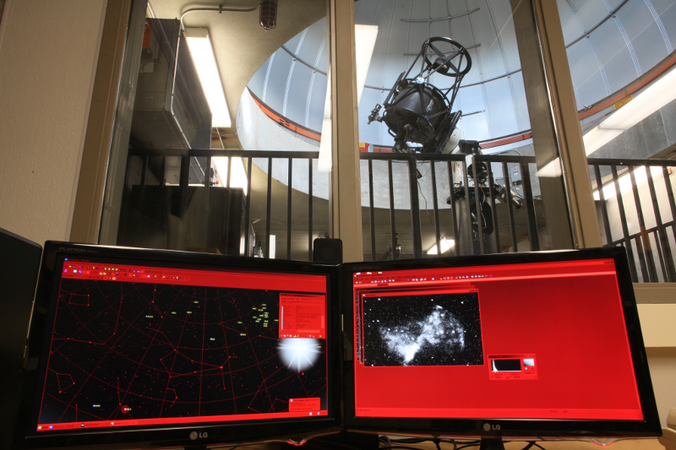
The Observatory
Notes:
Fully robotic observatory which means that everything is under computer control including
Telescope mount
Focus control
Camera
Filter Wheel
Dome
Three observing modes
Local Live, inside the control room
Public Nights
Intro Astronomy observing nights
Remotely through a web browser
Student Research projects
Remote access for other institutions
Unattended through an observing database
Innovative laboratory design!
Student Research projects

Slide 3
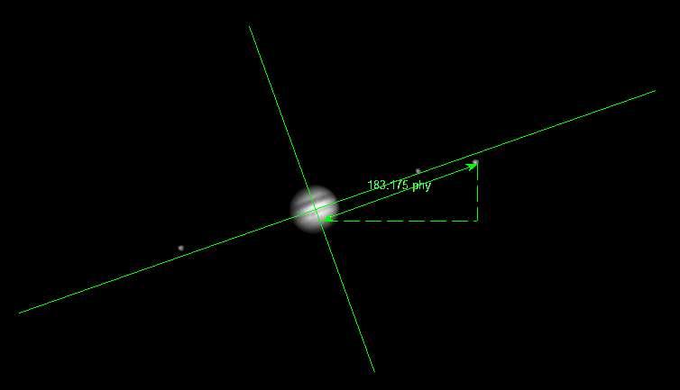
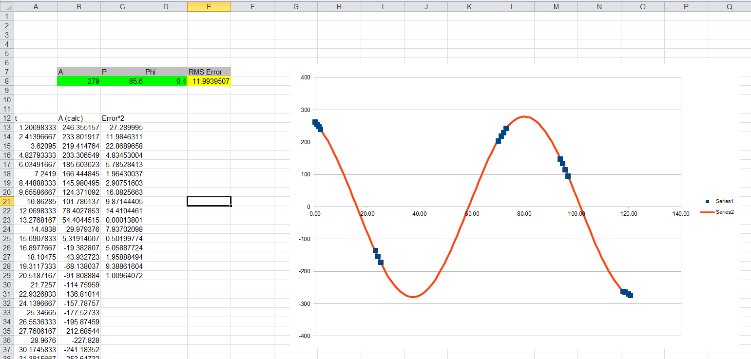
Curriculum
Notes:
We have an NSF grant to develop laboratories using the remote access/unattended capabilities.
Together with 6 institutions, UST, two community colleges, an R1, and a high school
Labs take two periods
Period 1, explore a scientific question, design an observing plan
Period 2, analyze the data from the remote instrument.
Lab 1, weigh Jupiter by measuring the orbital period of its moons
Lab is drafted and tested at UST
Larger scale test at partner institutions this fall
Laboratory design etc.

Slide 4
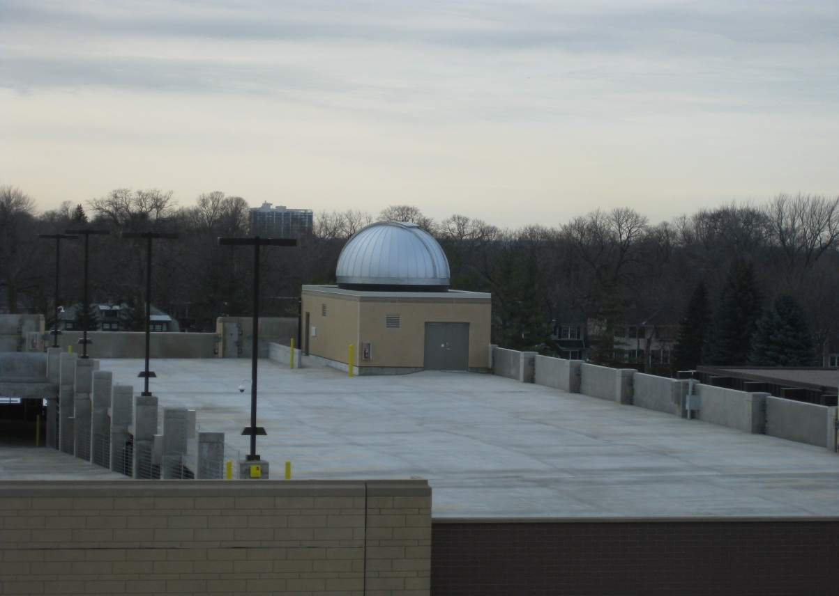
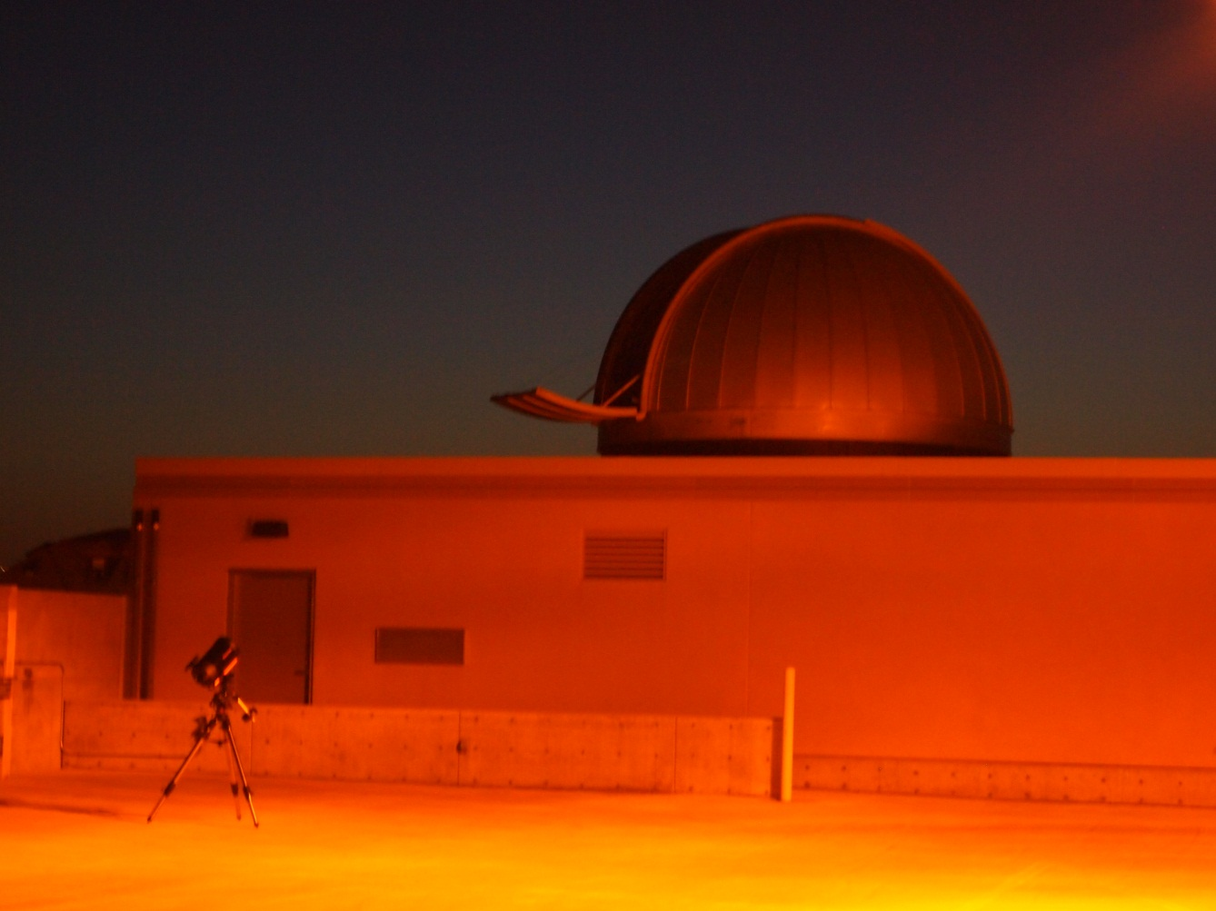
Light Controller
Notes:
The observatory is on a parking ramp
The tall lights on the big black poles are bright.
When they built it, I got push button switches.
Momentary contact button… toggles the state of the lights
And LED indicates the current state.
A photo sensor turns the lights on when the Sun goes down.
I need computer control of the lights
A controller that receives commands from the computer
When the controller is “active,” it watches the state of the LED
If the lights come on, it pulses the switch and turns them off.

Slide 5
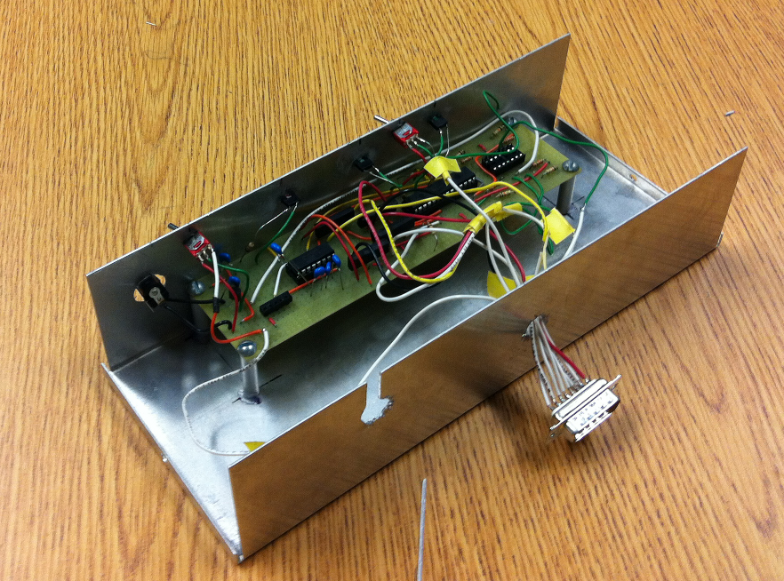
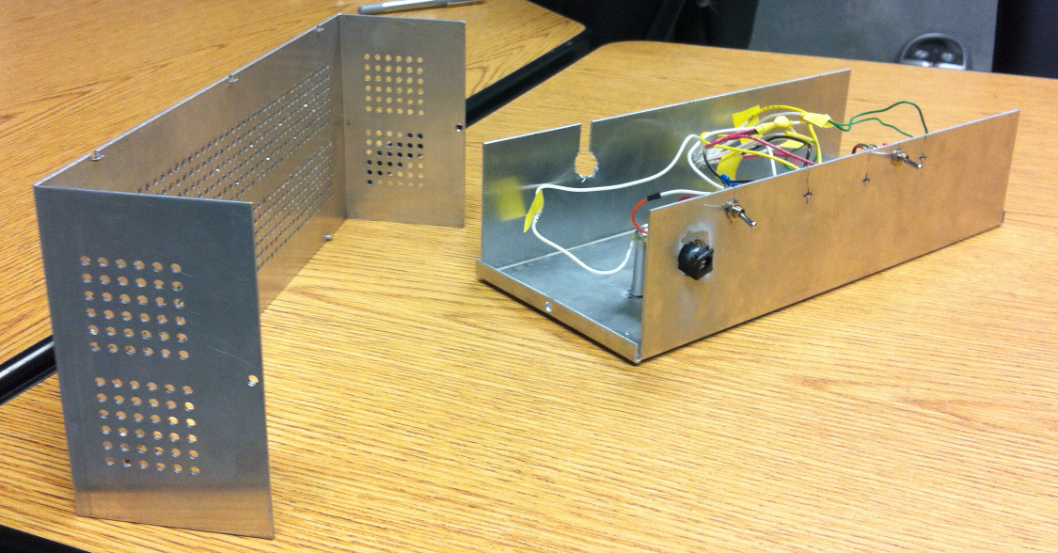
Attempt #1
Notes:
Three teams, two failures. Why did they fail?
Design number one – Summer student, project not for course grade.
Enthusiastic start,
Listened carefully to the design requirements but took no notes
Enthusiastically attacked the parts that were interesting to him
Got the project to the 80% level and lost enthusiasm.
Didn’t build in time for a prototype/debug cycle.
Tested at the very end of summer and, of course, it didn’t work in the production environment
Was difficult to get him to come back after the end of summer
The project remains incomplete
Teachable moments:
The project is less than 50% complete when it’s running on a breadboard on the bench.
Commitment to the customer regarding completion of the project.
This is hard to convey to students… they tend to not take projects with professors seriously.
This particular student had an internship and class commitments and his work with me was seen as secondary, even though he had made commitment.

Slide 6
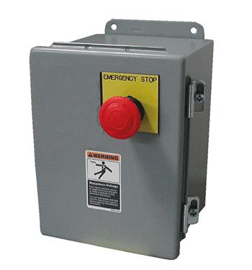
Attempt #2
Notes:
Done for a grade in a 300 level engineering class as a final project.
After reading the short project description, the students came up with several design ideas
During the customer interview, Rather than listening carefully, they pitched their ideas
Getting them to listen to the actual design criteria was a struggle
Their design ideas were based on an incomplete understanding of the project
The preliminary design suggested designs that highlighted their lack of complete understanding of the design requirements
Using a $25.00 power opto-isolater when a $3.00 part was completely sufficient.
Still entrenched in their preconceptions, they refused to listen to the voices of experience.
The team declared success even though the device was only bench tested and a major piece of functionality was untested.
Several customer requested features (status indicators etc) were not in the final prototype.
Teachable moment:
Listening carefully during the customer interview is critical.
Suggest alternative designs AFTER you FULLY understand the requirements
In fact, later in the process, they came up with an innovative design.
LISTEN to the experts. They just may have something important to say.
Commitment to the process. Everything must be tested. Never just assume that everything works
A successful bench test does NOT equal success in the production environment.

Slide 7
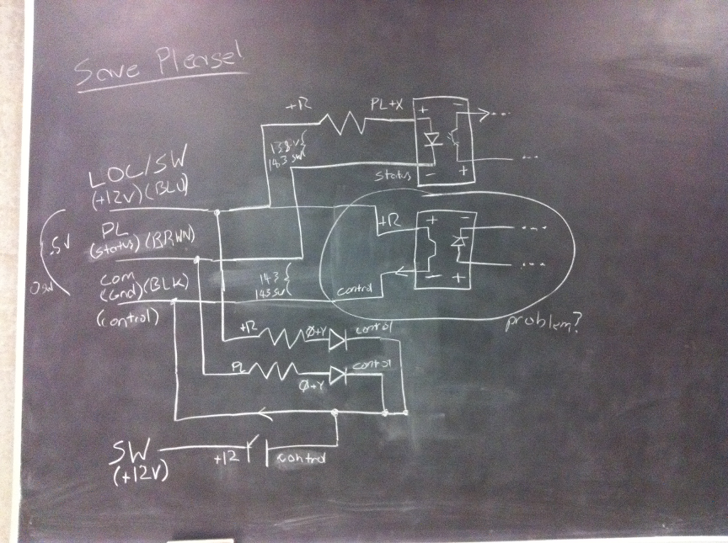
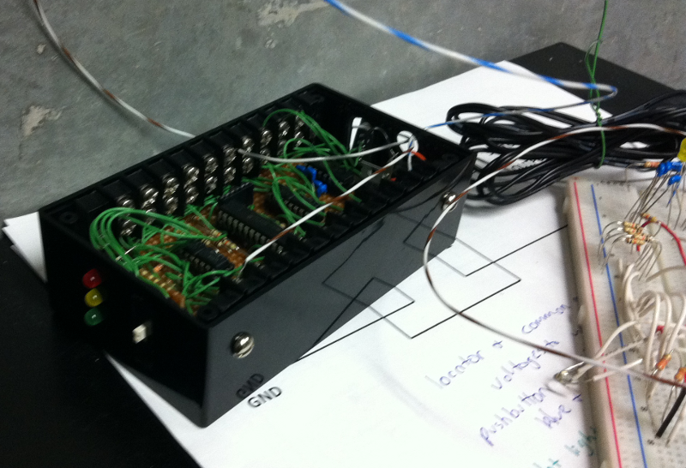
Attempt #3
Notes:
Again for grade for the same course.
Project 3: organized, thoughtful, allowed for debug, solid testing of all subsystems. Still failed in production environment…. We’re still working on it.
So… what are we doing wrong?
Proto-typing is only half of the game.
We need to clarify the difference between success on the bench versus success in production.
Perhaps some role playing?
Some practice making prototype enclosures would be nice also.

Slide 8
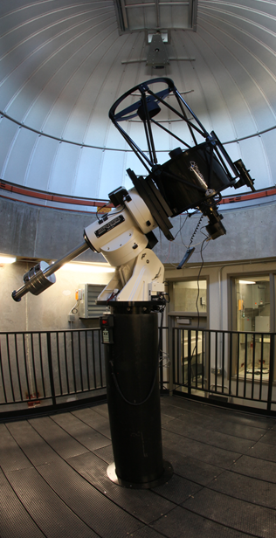
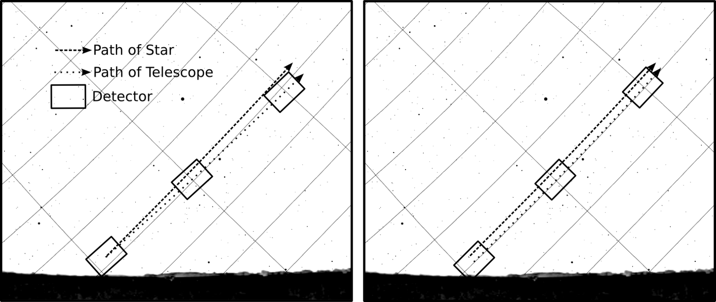
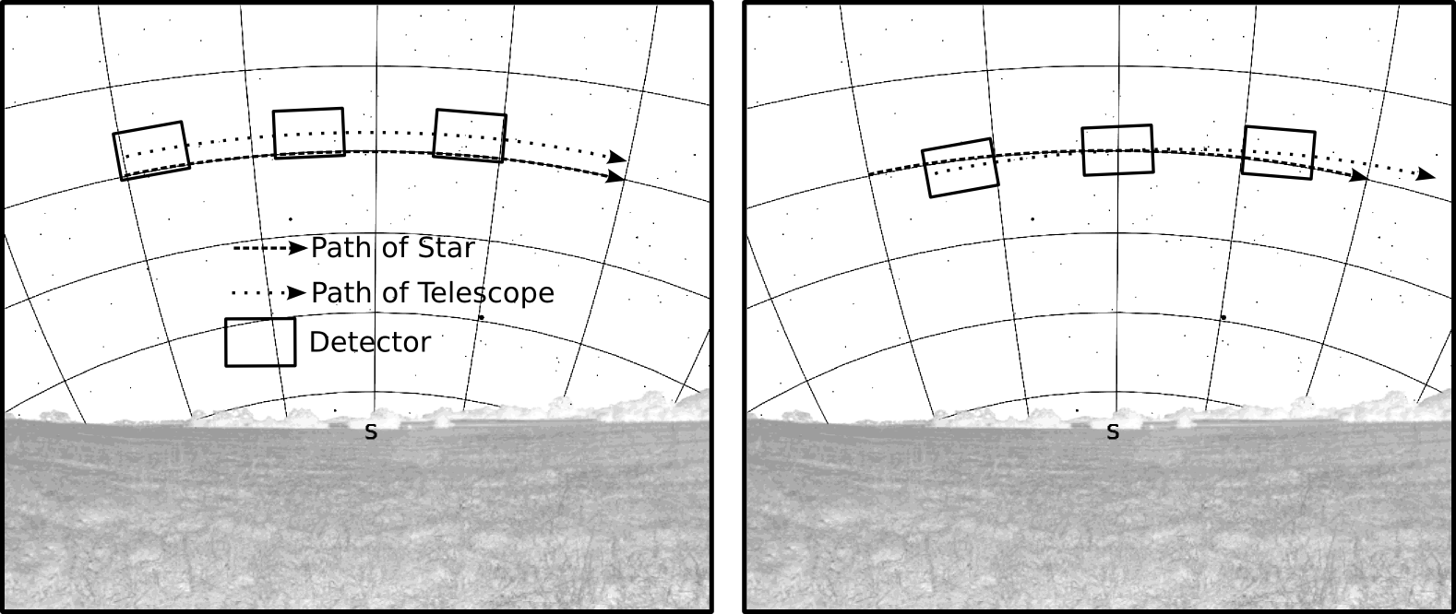
Polar Alignment
Notes:
Another successful engineering team.
Again for course grade but this time as an alternative to the Physics 104 lab.
This time the communication was very clear and the project was very well defined.
Solutions already existed, so it was mostly research and sythnthesis.

Slide 9
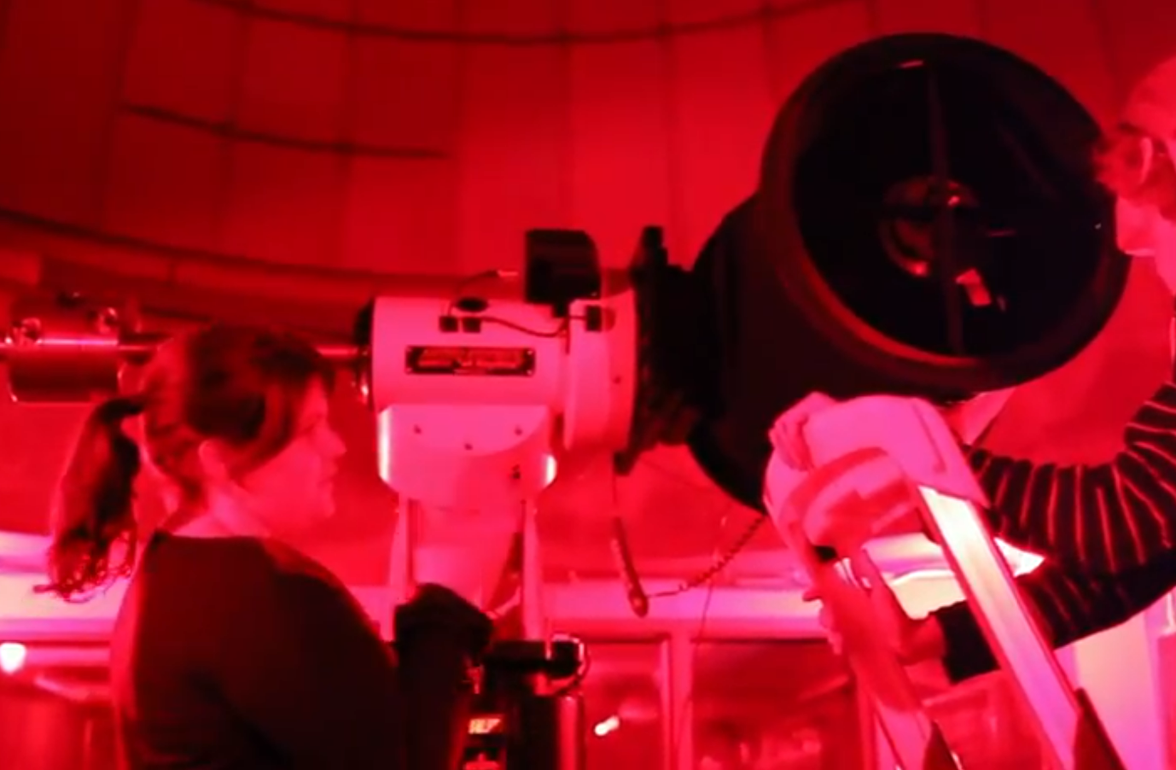
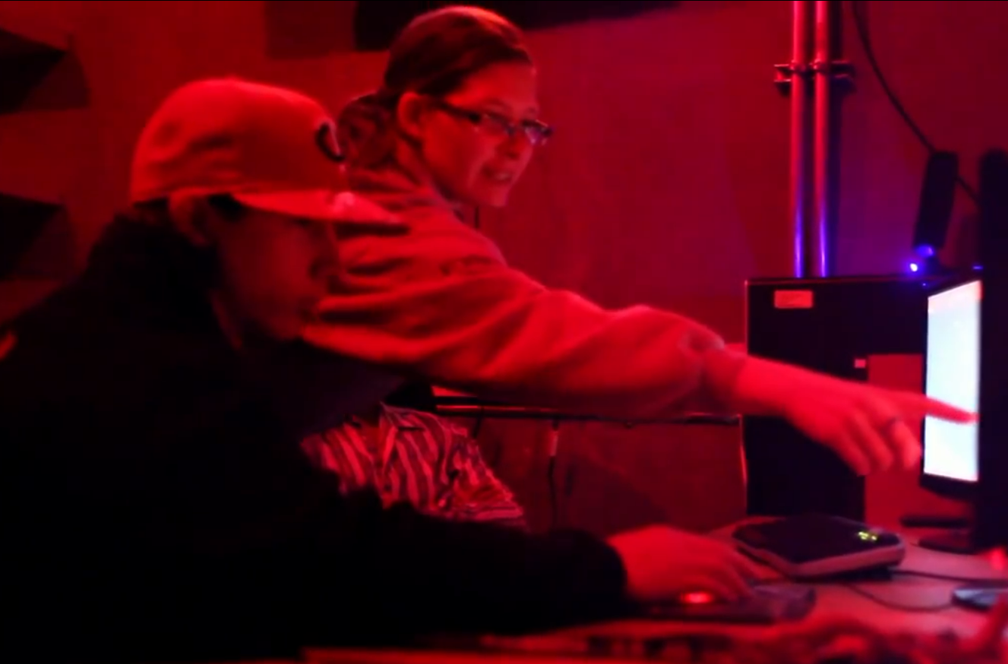
Student Workers
Notes:
So…
Communication?
We need to develop a way to lead students through the entire design cycle.
The successful students were good at listening and able to synthesize their knowledge

