Slide 1
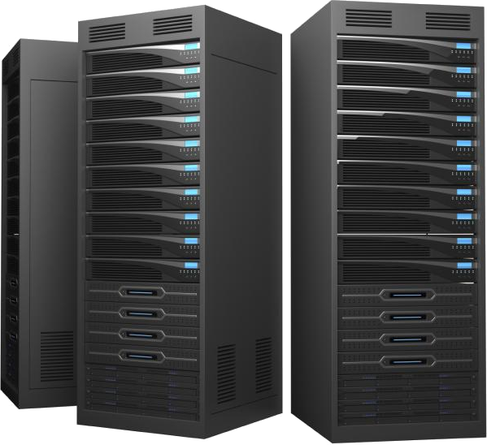
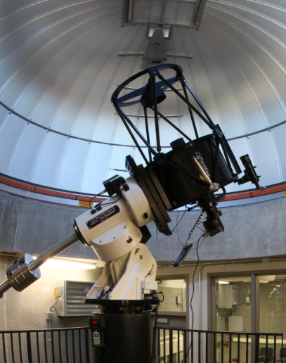
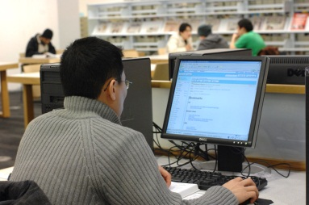
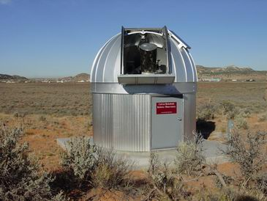
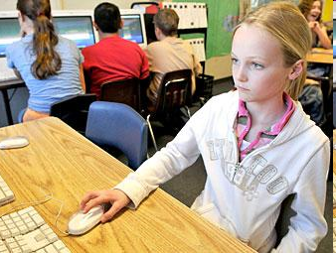
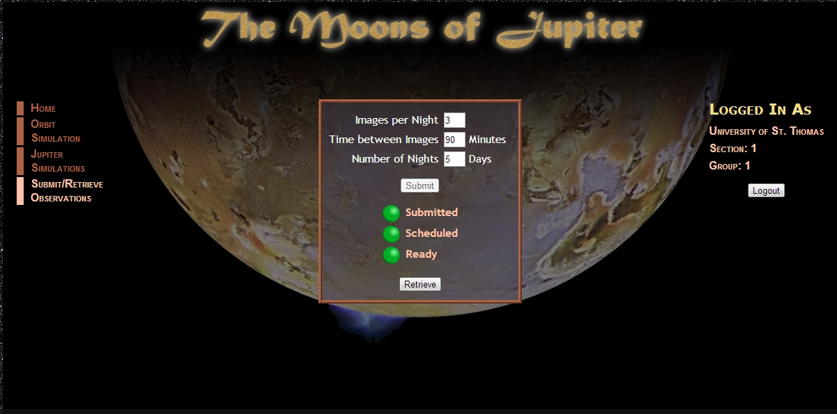
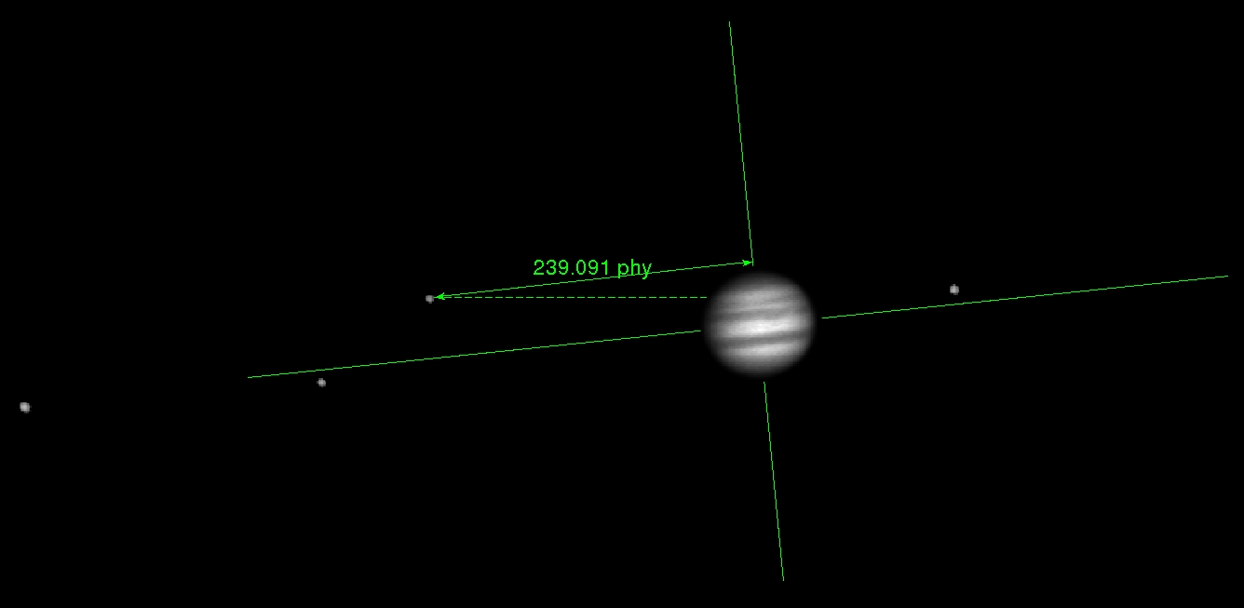
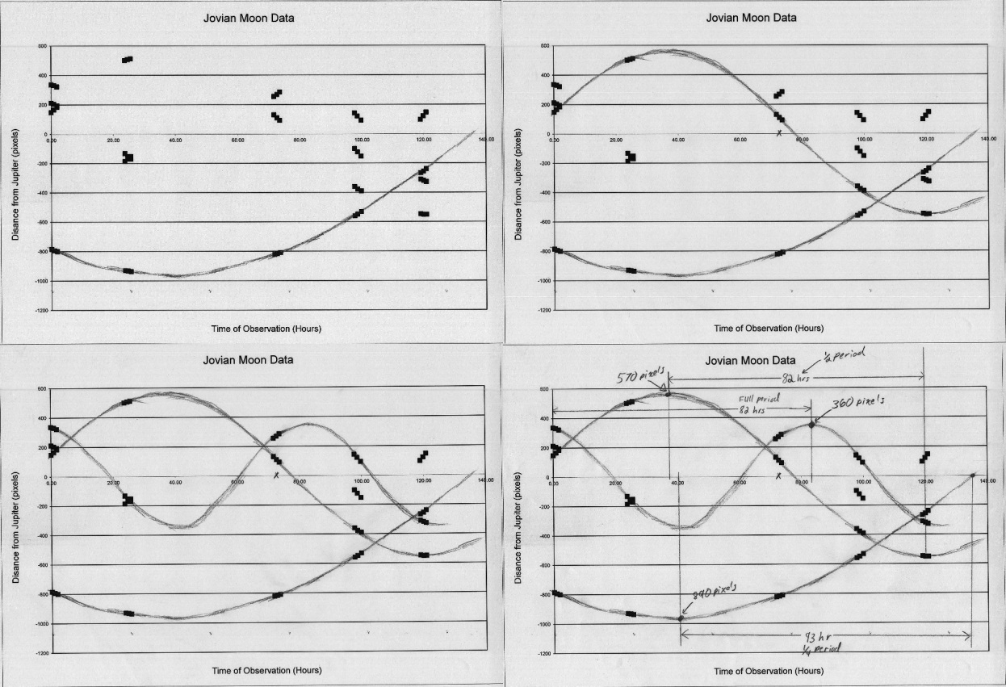
Robotic Observatories in Astro 101
Gerald T. Ruch Jr University of St. Thomas
Abstract: The University of St. Thomas (UST) and a consortium of five local schools are using the UST Robotic Observatory, housing a 17' telescope, to develop labs and image processing tools that allow easy integration of observational labs into existing introductory astronomy curriculum. Our lab design removes the burden of equipment ownership by sharing access to a common resource and removes the burden of data processing by automating processing tasks that are not relevant to the learning objectives. Each laboratory exercise takes place over two lab periods. During period one, students design and submit observation requests via the lab website. Between periods, the telescope automatically acquires the data and our image processing pipeline produces data ready for student analysis. During period two, the students retrieve their data from the website and perform the analysis. The first lab, "Weighing Jupiter," was successfully implemented at UST and several of our partner schools
Data Processing Center
Planning Assistance
Hide distracting technical details
Create Detailed Plan
Data Preparation
Basic Image Processing
Image Calibration
Data Package Preparation
Classroom
Period One
Investigate topic
Create Plan
Submit Plan
Period Two
Retrieve Data
Analyze Data
Report Results
Robotic Observatories
Share Access to State of the Art Facilities
Unattended Operation
Remote Location
Ideal Weather Conditions
The Internet
Lab 1 - Weighing Jupiter
Students investigate the power of Kepler’s Law to obtain Jupiter’s Mass. They devise and submit an observing plan
Students measure the positions of each of the four Jovian Moons in the resulting time series of images. But which moon is which?
After plotting the moon positions versus time, the students must extract the orbital parameters
This work was supported in part by National Science Foundation grant number DUE-1140385
Notes:
Leave details for the student.
Remove distracting technical details.

